Slide 1
EFFICIENCY AND PERFORMANCE OF VUSIONCLOUD
Labels connected
78 Million (Oct. 23)
Stores connected
Average monthly label updates
176 Million (2023)
16,519 (Oct. 23)
01
03
Supports retailers’ digitalization projects VusionCloud simplifies retailers’ transition to digital by integrating data through APIs and providing tools for designing label templates
Facilitates roll-outs in store VusionCloud optimizes and tracks stores roll-outs with Its dedicated interface and enables seamless deployments through integration with third-party access points
Enables remote and efficient store management VusionCloud's monitoring interfaces simplify remote management, ensuring an efficient use of in-store IoT and helping maximize return on investment (ROI)
Featuring, dedicated tools and custom alerts, VusionCloud helps streamline day-to-day operations
Simplifies IoT second or end of life VusionCloud helps retailers monitor and oversee the warranty status of their assets, optimizing the end-of-life management of their labels.
VusionCloud provides a digitized return process and the capability to analyze the root causes of returns
A 360° Cloud Solution
VusionCloud is a Retail IoT Management platform
for retailers to remotely monitor digital price tags and IoT devices. It offers a comprehensive in-store device monitoring, from tracking shipments to simplifying warranty processes. VusionCloud enables the digitalization of retail with security, scalability, and cost control through a SaaS model
02
04

Slide 2
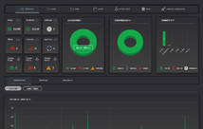
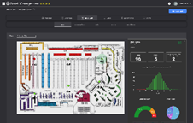
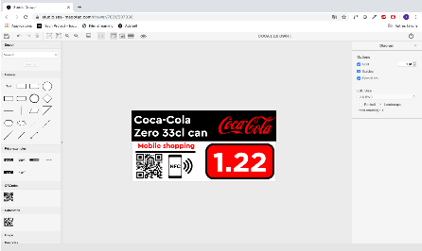
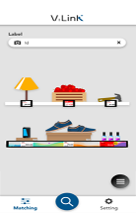
RESULTS AND IMPACT OF VUSIONCLOUD
Global Scalability NAM, APAC, EMEA
Highest Reliability
Highest security
Highest Performance APIs
99.95 % Availability
Labels: 78 Million
4 hours Recovery Time Objective
4 hours Recovery Point Objective
>24B API calls/Year
<200ms Response time
Stores: 16,519
+800 Active users
Real-time label management & monitoring
Assets usage & lifespan optimization
Data configuration & Template design
Operations directly at the shelf

